Slide 1
Basis Path Testing

Slide 2
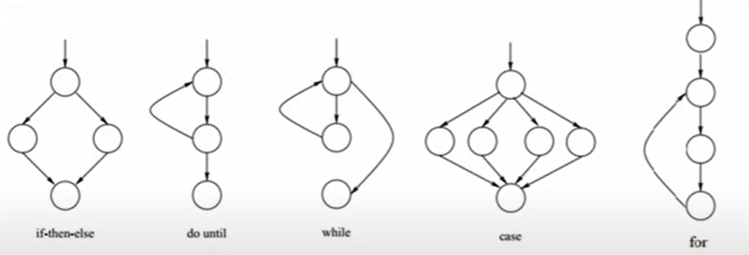
Control flow graph symbols & CC formula
CC = E – N + 2P

Slide 3
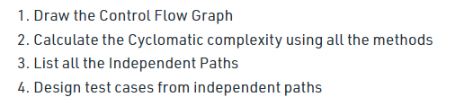
Basis Path testing

Slide 4
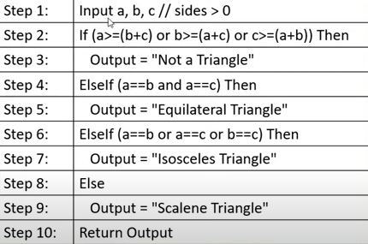
Example 1 -- Step-1: label steps

Slide 5
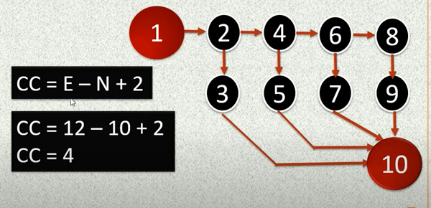
Step-2: create graph

Slide 6
Step-3: select paths
1-2-3-10
1-2-4-5-10
1-2-4-6-7-10
1-2-4-6-8-9-10

Slide 7
Step-3: create tests
If | Else if | Else if | Else | Expected outcome
T | F | F | F | Not a triangle
F | T | F | F | Equilateral
F | F | T | F | Isosceles
F | F | F | T | Scalene

Slide 8
Example 2: perform basis path testing for following code
public double calculate(int amount) {
-1- double rushCharge = 0;
-1- if (nextday.equals("yes") ) { -2- rushCharge = 14.50; }
-3- double tax = amount * .0725;
-3- if (amount >= 1000) { -4- shipcharge = amount * .06 + rushCharge; } -5- else if (amount >= 200) { -6- shipcharge = amount * .08 + rushCharge; } -7- else if (amount >= 100) { -8- shipcharge = 13.25 + rushCharge; }
-9- else if (amount >= 50) { -10- shipcharge = 9.95 + rushCharge; }
-11- else if (amount >= 25) { -12- shipcharge = 7.25 + rushCharge; } else { -13- shipcharge = 5.25 + rushCharge; }
-14- total = amount + tax + shipcharge; -14- return total;
} //end calculate

Slide 9
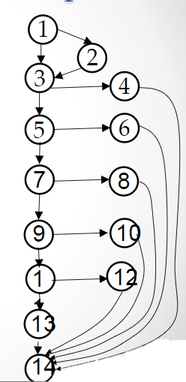
Step 1 & 2: label code and create control flow graph
public double calculate(int amount) {
-1- double rushCharge = 0;
-1- if (nextday.equals("yes") ) { -2- rushCharge = 14.50; }
-3- double tax = amount * .0725;
-3- if (amount >= 1000) { -4- shipcharge = amount * .06 + rushCharge; } -5- else if (amount >= 200) { -6- shipcharge = amount * .08 + rushCharge; } -7- else if (amount >= 100) { -8- shipcharge = 13.25 + rushCharge; }
-9- else if (amount >= 50) { -10- shipcharge = 9.95 + rushCharge; }
-11- else if (amount >= 25) { -12- shipcharge = 7.25 + rushCharge; } else { -13- shipcharge = 5.25 + rushCharge; }
-14- total = amount + tax + shipcharge; -14- return total;
} //end calculate

Slide 10
Step 3: identify paths
P-01: 1, 2, 3, 5,7,9,11,13,14
P-02: 1,3,4,14
P-03: 1,3,5,6,14
P-04: 1,3,5,7,8,14
P-05: 1,3,5,7,9,10,14
P-06: 1,3,5,7,9,11,12,14
P-07: 1,3,5,7,9,11,13,14
P-05: 1,3,5,7,9,10,14
P-06: 1,3,5,7,9,11,12,14
P-07: 1,3,5,7,9,11,13,14

Slide 11
Step 4: define test case
P-05: 1,3,5,7,9,10,14
P-06: 1,3,5,7,9,11,12,14
P-07: 1,3,5,7,9,11,13,14
Path # | Amount | NextDay | Expected outcome
2 | 1500 | Yes | ?
1 | 10 | Yes | ?

Slide 12
Example 2: perform basis path testing for following code

Slide 13
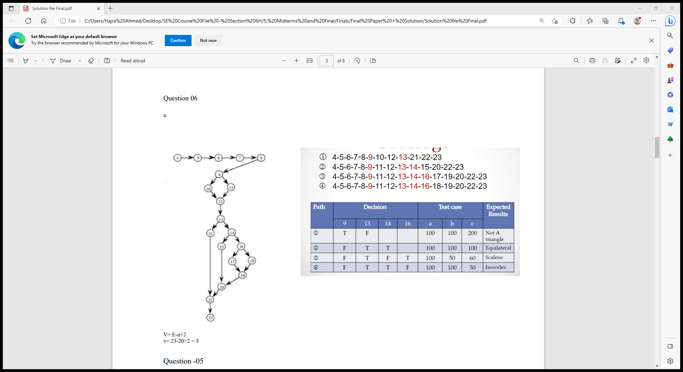
Example 2: perform basis path testing for following code

Slide 14
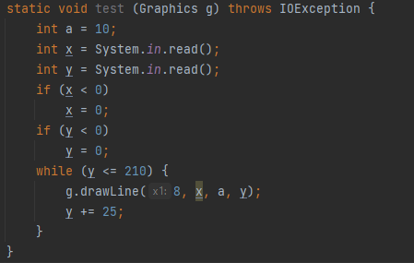
Example 3: Create control flow graph &
calculate Cyclomatic Complexity

Slide 15
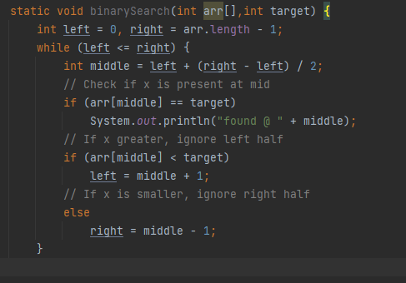
Example 4: Create control flow graph & identify paths

